Slide 1
Rat update 2/10/2020
Project outline:
Design organism and restore data in Matlab.
Process and load Kinematics/Dynamics data
Inverse Kinematics
Inverse Dynamics

Slide 2
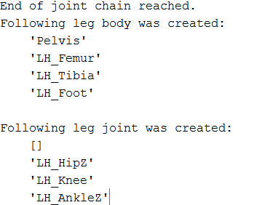
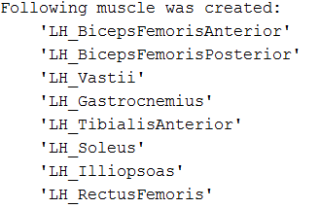
Design organism and restore data in Matlab.
Load .aproj of Animatlab to the Matlab
Use the findstr() function to identify information from the .aproj
Store the data in the objective function. (obj.leg obj.joint obj. muscle)

Slide 3
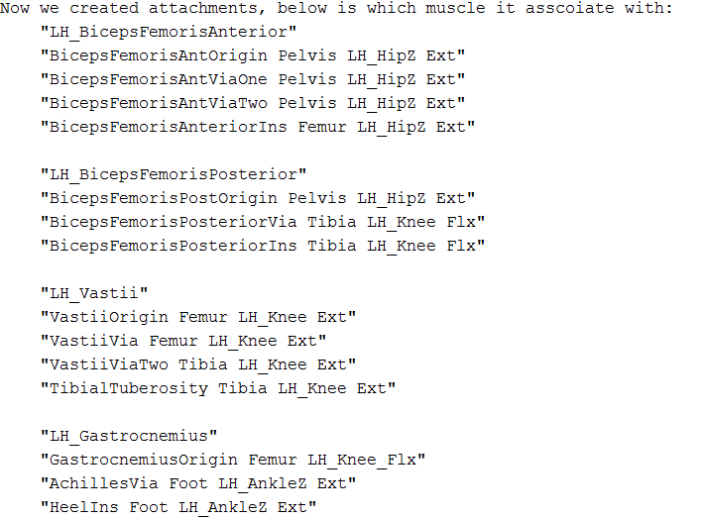
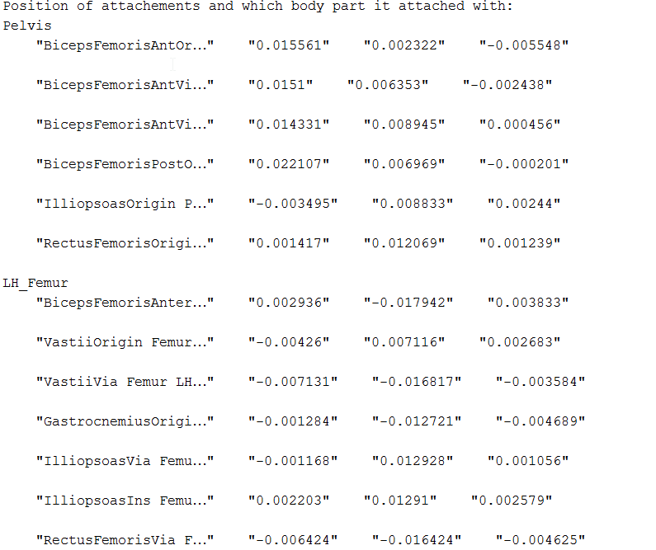
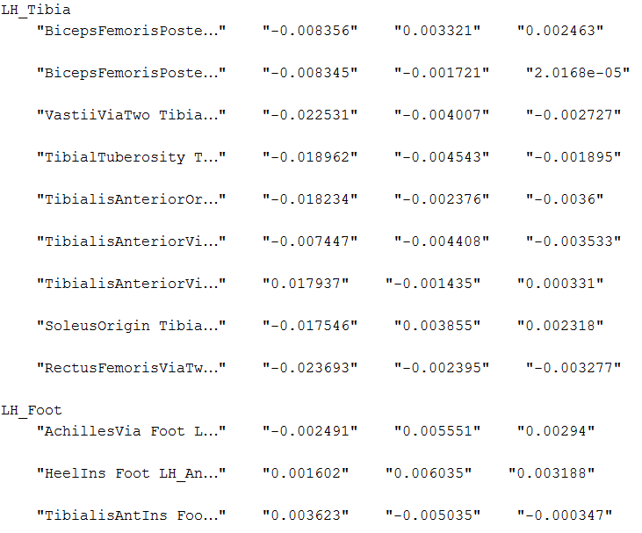
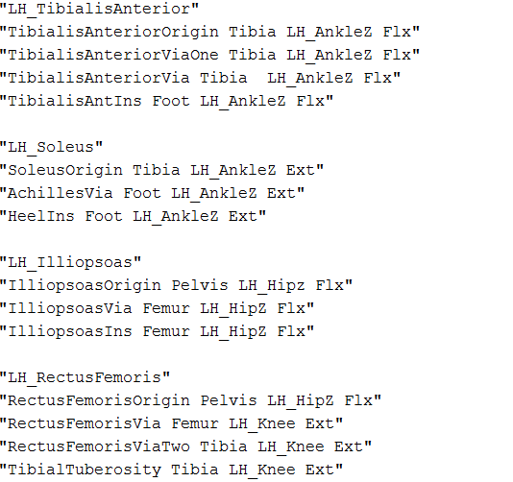
Store muscle attachments associate with muscle:
Store attachments position relative to body:

Slide 4
Process and load Kinematics/Dynamics data

Slide 5
Inverse Kinematics

